Slide 1
Wireless Control of a Ground Vehicle through Internet and Gestures
Assignment 1
Software for embedded systems
Vaibhav Gupta | Tarang Shah
2011A8PS255P | 2011A8PS279P

Slide 2
Problem Statement
To develop a ground vehicle which is capable of doing simple function like move Forward, Back, Left Turn, Right Turn and Stop. The vehicle will be wirelessly controlled using two technologies – Through Internet and through gestures. An embedded system will be used to perform these functions.
For an internet controlled vehicle - a webpage will be developed which can be opened on the clients computer. It contains buttons which can be pressed by the user to send commands. When the user presses a button on the webpage, it will send the command to a webserver . The system -Rasberry-Pi which is connected to internet, will check for new commands on the server. If a new command is found, the system will execute it on the vehicle.
In gesture control an android device is used. The device will use its accelerometer and Bluetooth capabilities. The user will tilt the android device which will send the commands over Bluetooth. The system will then execute the command. A switch will be provided on the bot to choose control configuration

Slide 3
Problem Description
Ground Vehicle
Interfacing with the motors
Receiver for Internet Commands and Bluetooth Commands
Web Page and Web Server
Web page to Give commands to the Robot – Forward, Backward, Left, Right, Stop
Web Server will store the commands and Send them to the Robot
Bluetooth Application ( Android App)
Will contain Code to Interface with Bluetooth on phone
Interface with phone accelerometer
Detect Tilt Gestures and send corresponding command

Slide 4
System Description
Hardware
Raspberry Pi interfaced with motors
Wireless Dongle to connect Raspberry pi to Internet
Android Phone with Bluetooth and Accelerometer
Software
Java Application on Raspberry Pi
Javascript based webpage for Internet Control
Android Application for Gesture control

Slide 5
Use Cases
Webpage Use case
Android Device Use case
Ground vehicle System Use Case

Slide 6
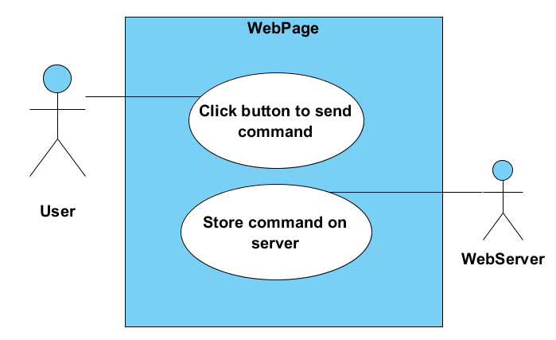
Webpage Use case

Slide 7
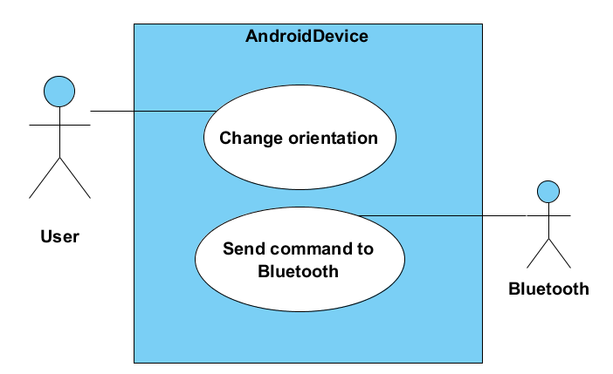
Android Device Use Case

Slide 8
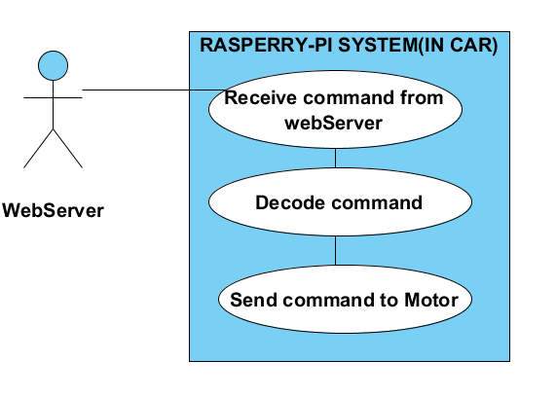
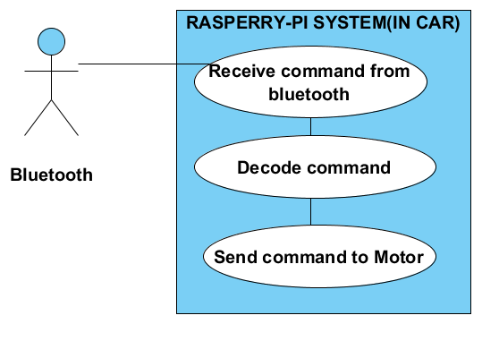
Ground vehicle Use Cases

Slide 9
Activity Diagrams
Webpage
Android Device
Ground Vehicle
Internet Control
Gesture Control

Slide 10
Webpage Activity Diagram

Slide 11
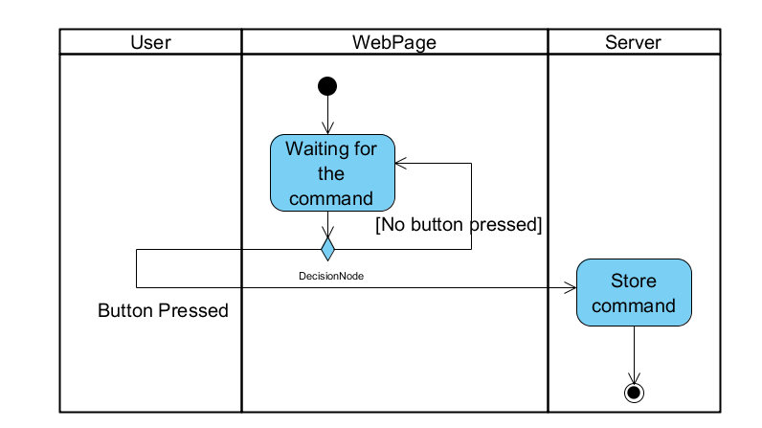
[ ]

Slide 12
Android Device Activity Diagram

Slide 13
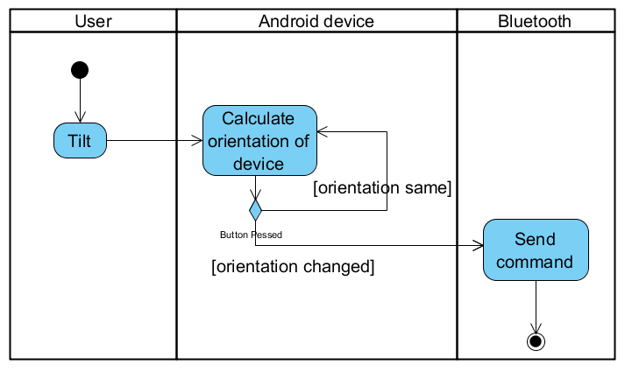

Slide 14
Ground Vehicle Internet Control Activity Diagram

Slide 15
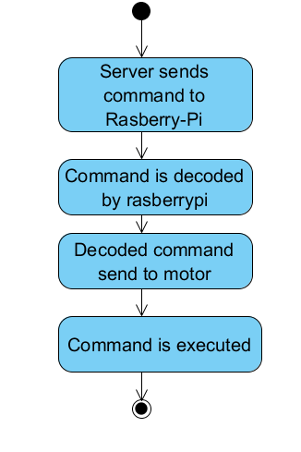

Slide 16
Ground Vehicle Gesture Control Activity Diagram

Slide 17
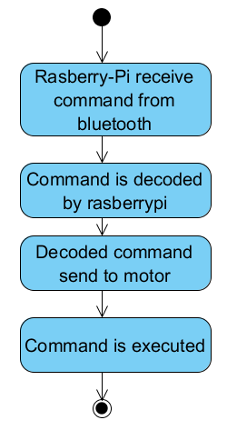

Slide 18
Class Diagrams
Ground vehicle System
Bluetooth Controller App
Only classes that we are going to implement have been mentioned. Standard Classes from Libraries have not been Included to make the diagrams clutter free.

Slide 19
Ground Vehicle System

Slide 20
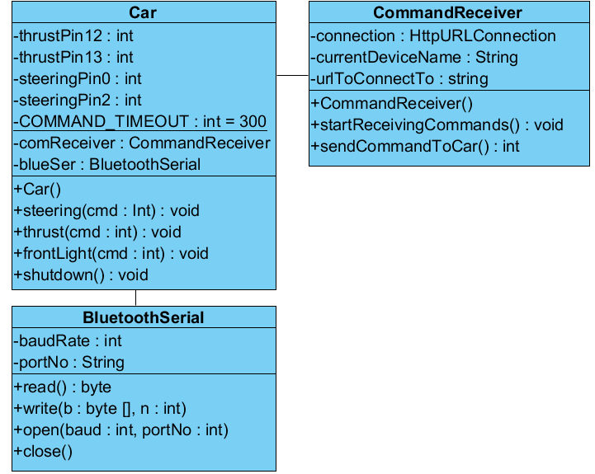
1 1
1
1

Slide 21
Bluetooth Controller App

Slide 22
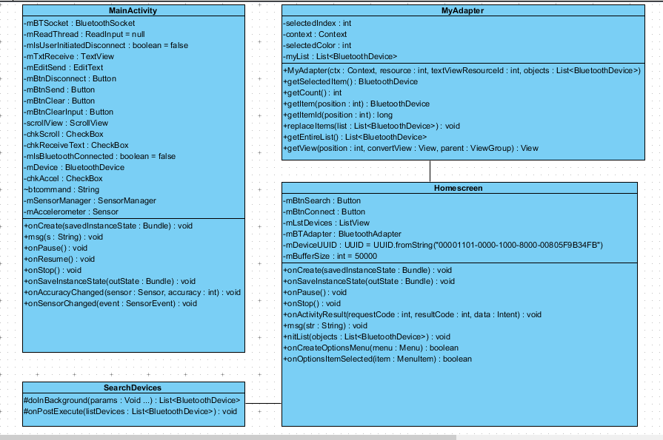
1
1
1 1

Slide 23
Stages of Development
Stage1
Developing Android Application & implementing class diagrams
Testing and debugging the gesture control
Stage 2
Developing the hardware
Developing the software for controlling the hardware.
Stage 3
Developing the webpage and web server
Testing the data transfer through internet
Stage 4
Final Integration of all components

Slide 24
Applications and further developments
Possible addition of Camera
Help in remote monitoring of hazardous areas
User can see the live images on a webpage and control the bot at the same time
Robotic trolley for transporting material from one place to another
Web based control system can be used to control Various embedded devices over internet.
Home automation

